Slide 1

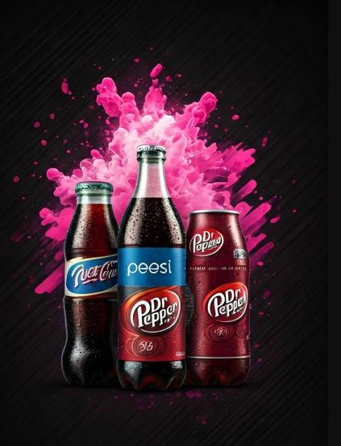
BEVERAGE SALES ANALYSIS

Slide 2

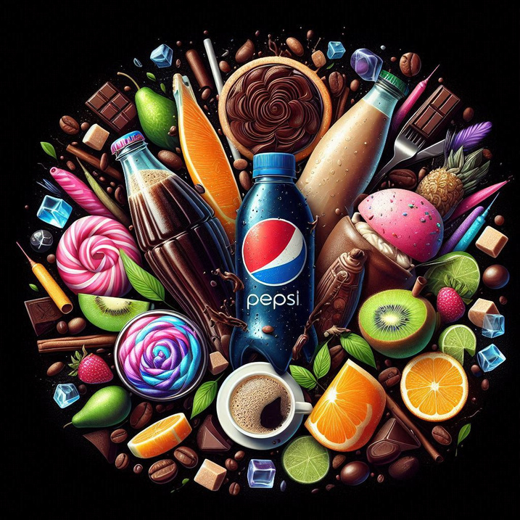
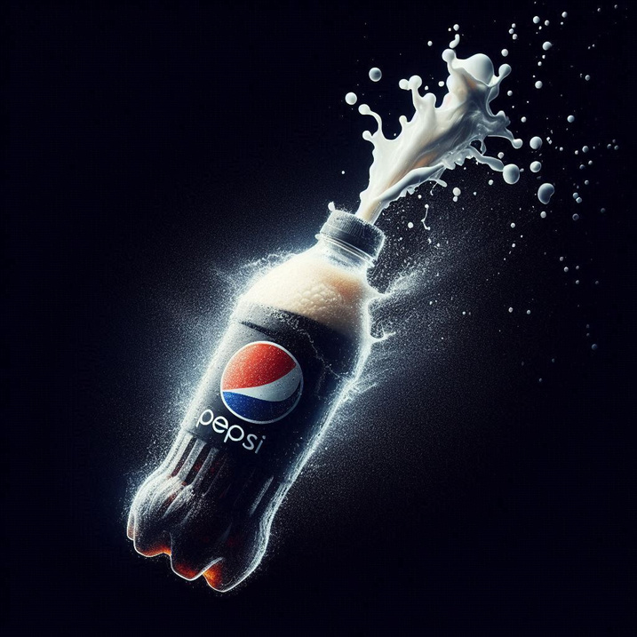
PROBLEM STATEMENT
Some Beverage companies, leading distributor of consumer products, was facing a pressing issue—inconsistent sales performance across different regions. While some areas thrived, others lagged behind, causing a disconnect between budgeted and actual sales. Profit margins fluctuated, and managers struggled to pinpoint the root causes behind the underperformance.
Company executives grew concerned. Were certain products not performing well? Were sales managers assigned inefficiently? Was regional demand being misjudged? Without concrete data-driven insights, decision-making felt like a guessing game.
To tackle this, they turned to their data analytics team, seeking clear, actionable insights that could help them identify trends, optimize sales strategies, and boost profitability across all regions. The challenge was set—could data unlock the secrets behind their sales struggles?

Slide 3
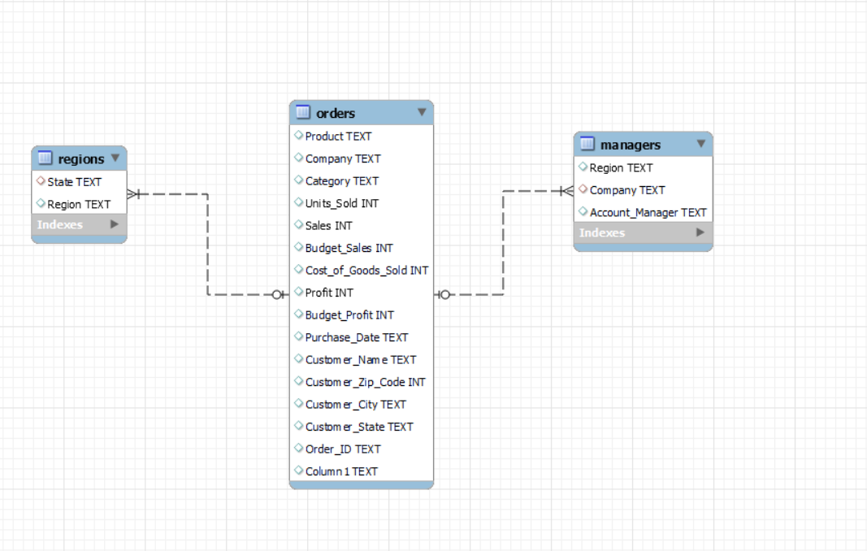
DATA MODEL

Slide 4
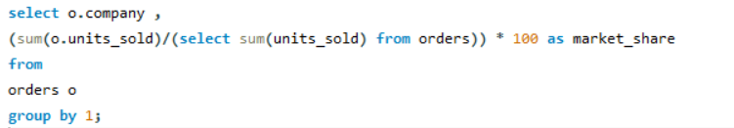
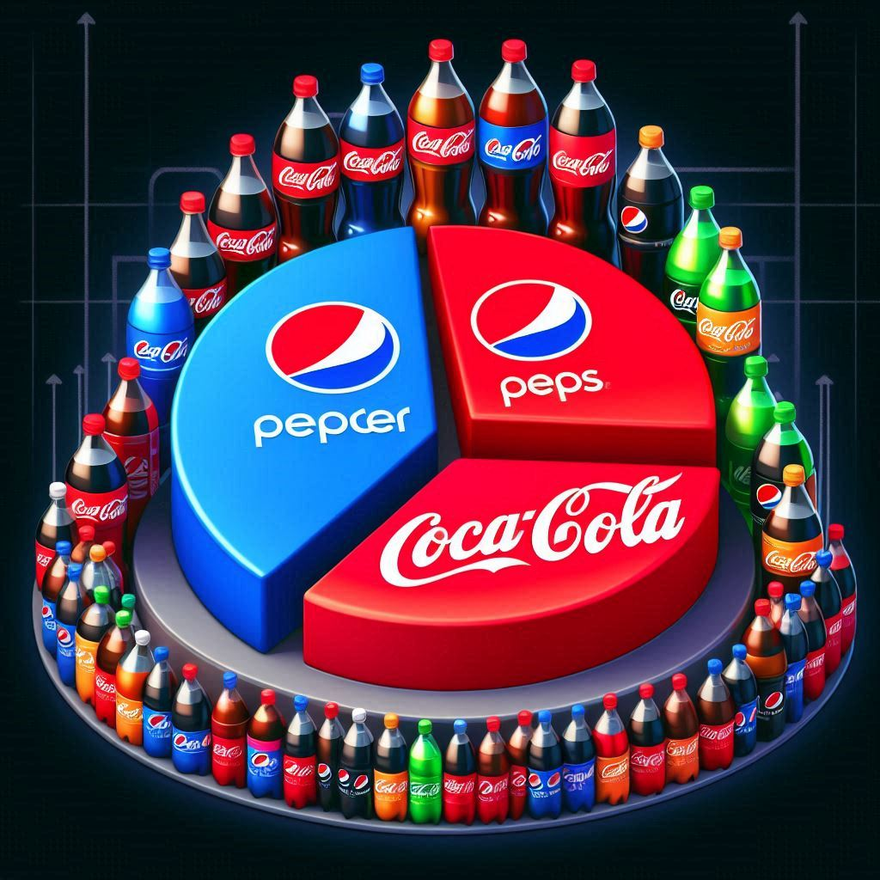
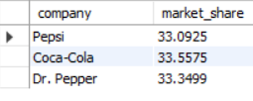
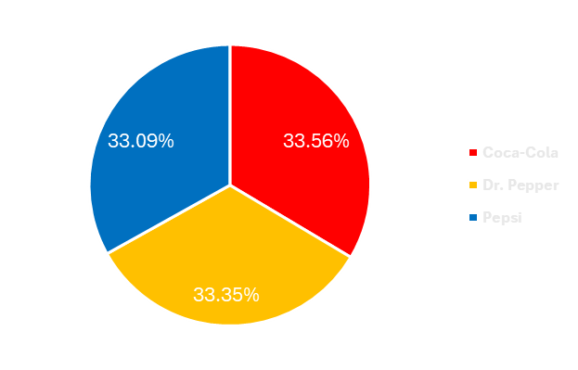
Market Share of Each Company

Slide 5
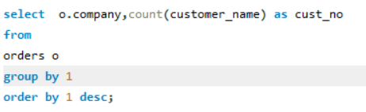
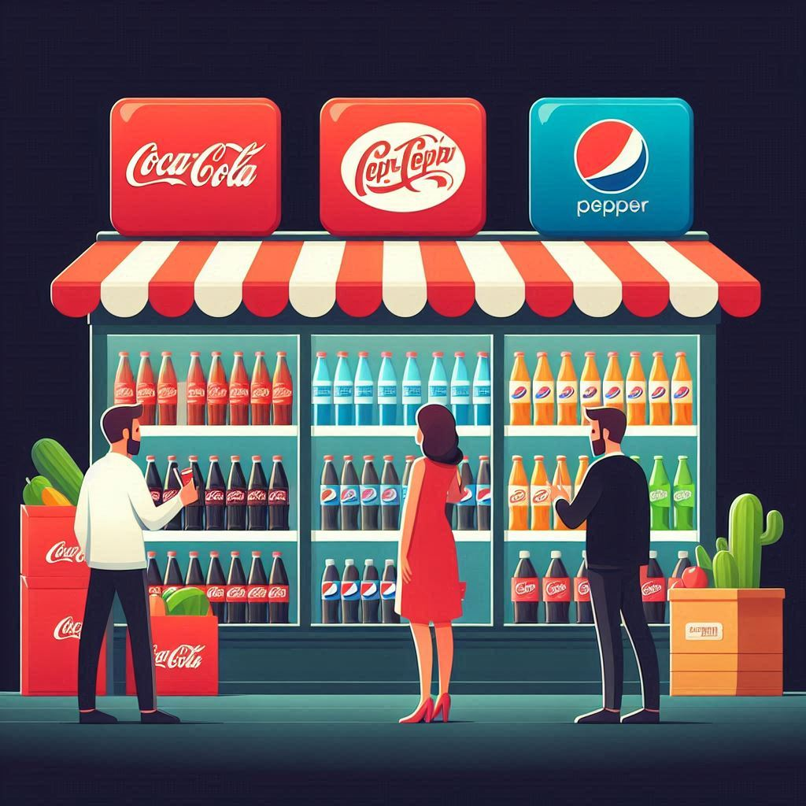
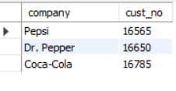
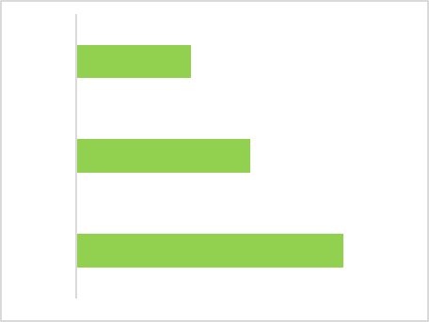
Customer Count Of Each Company

Slide 6
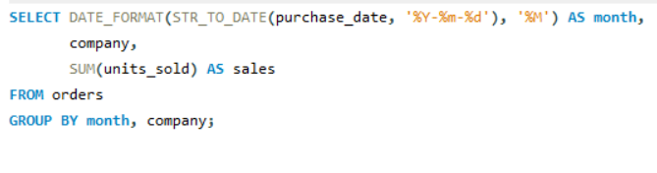
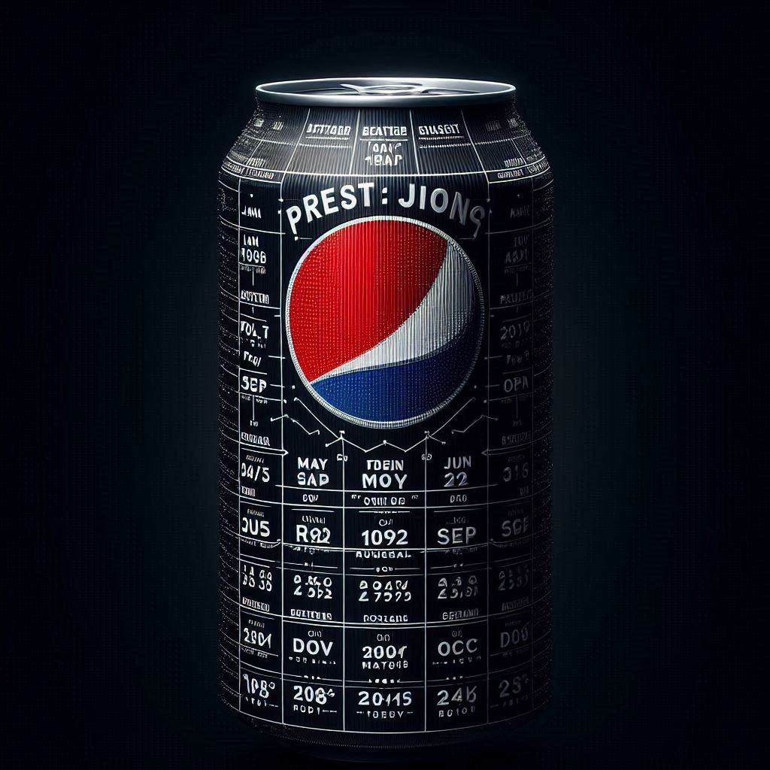
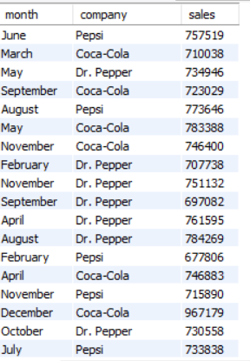
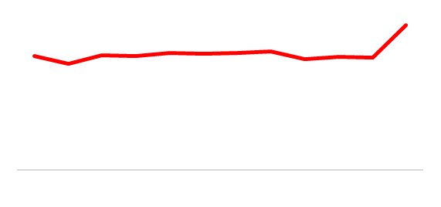
Month Wise Trends In Sales

Slide 7
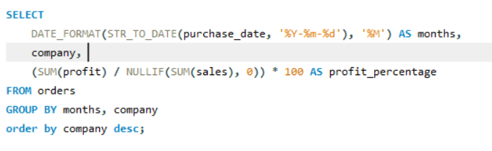
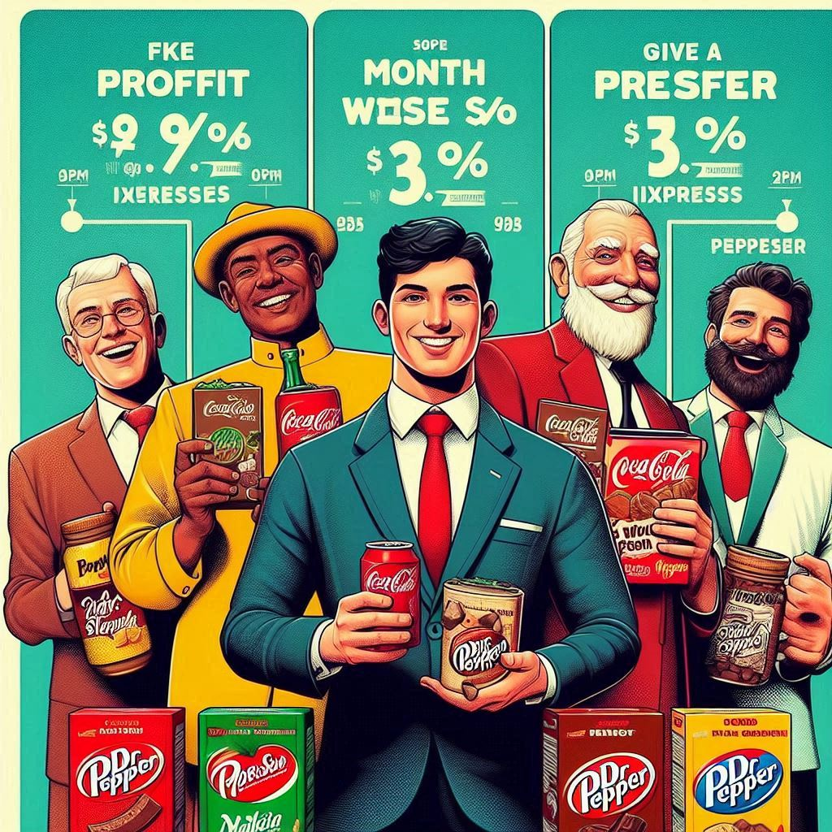
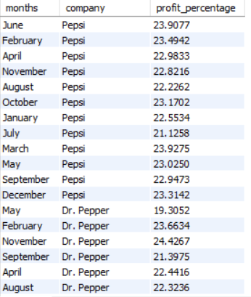
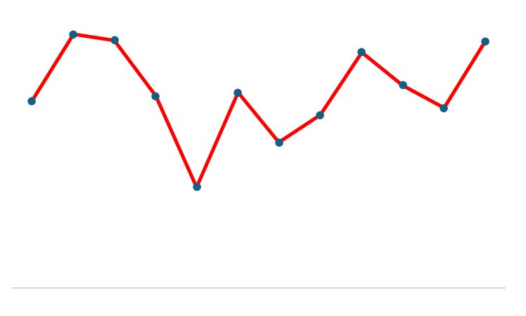
Profit Variation in Months

Slide 8
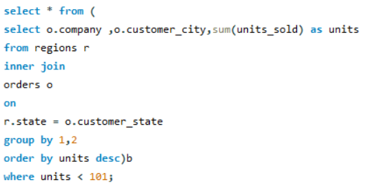
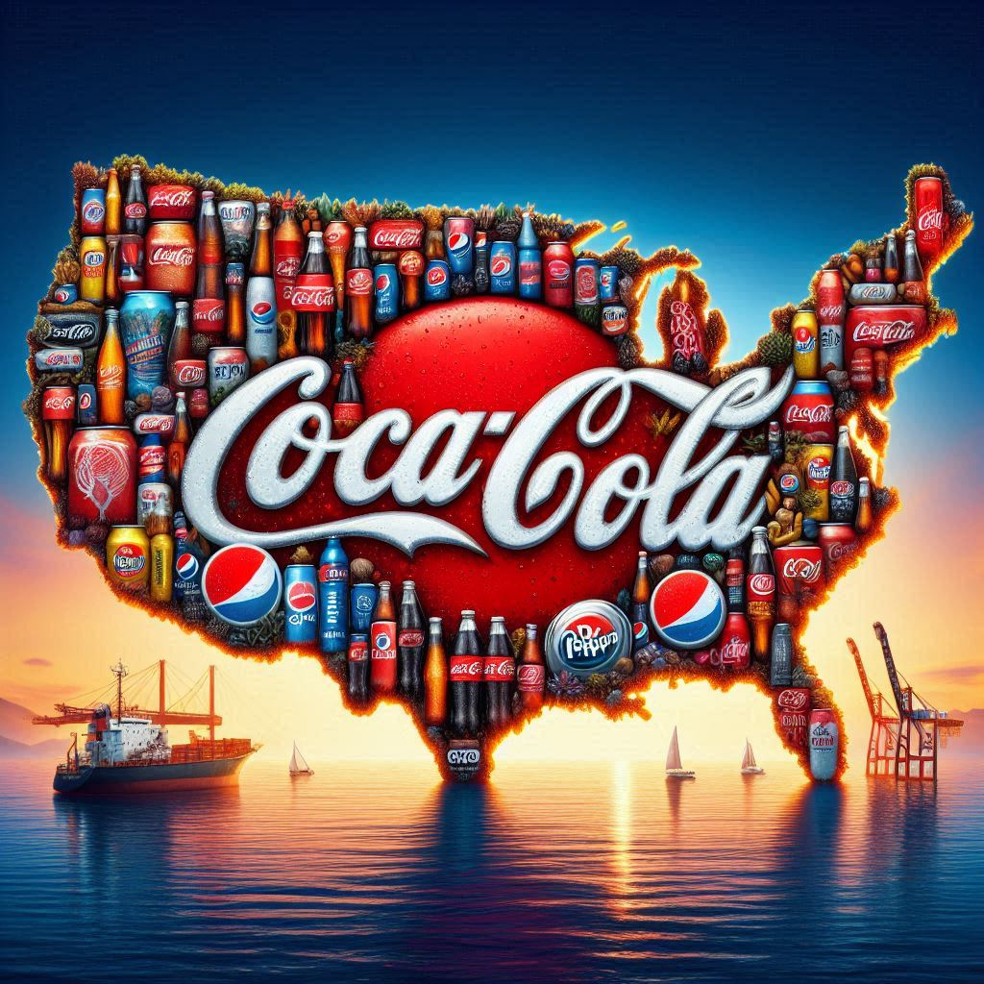
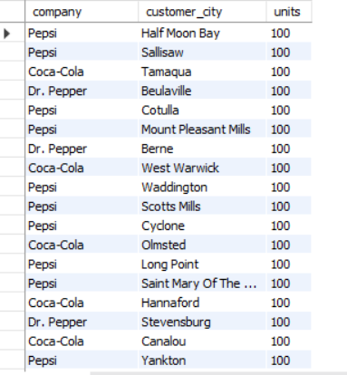
Region With Low Unit Sales

Slide 9
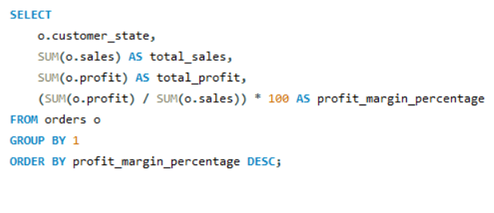
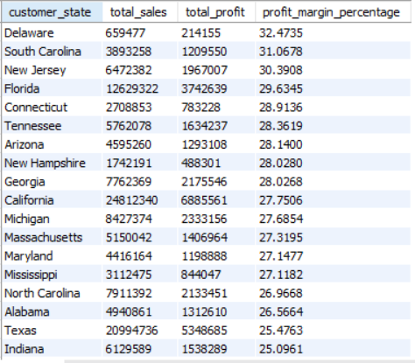
State Performance in Profits

Slide 10

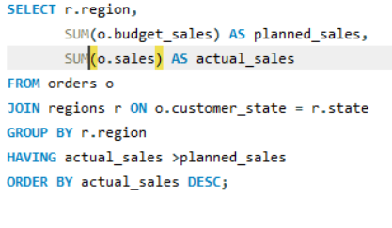

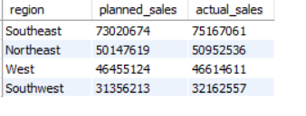
Regions Where Actual Sales > Planned Sales

Slide 11
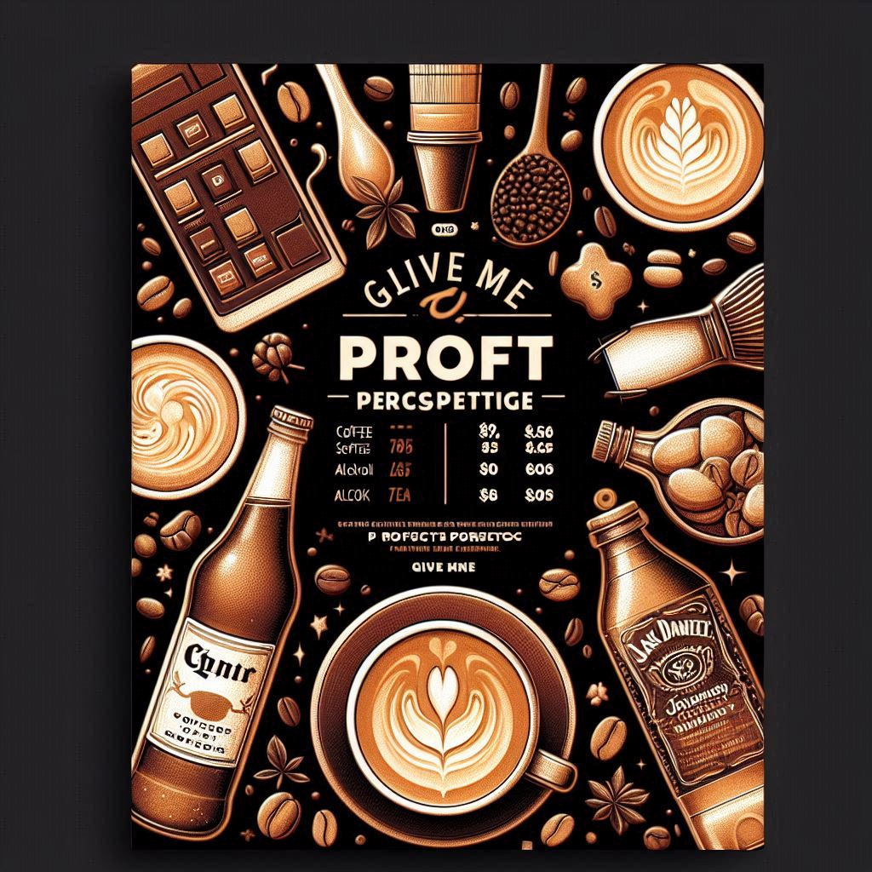
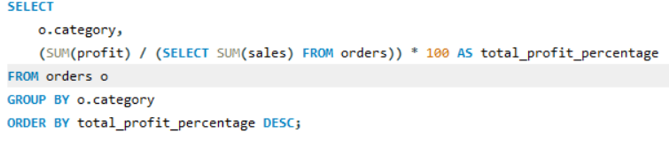
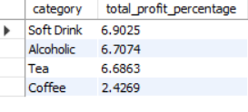




Profit % By Category

Slide 12

OBSERVATIONS
1.All Companies are having the equal and tough competition in the market , each of them are trying their best to improve their sales 2.Customers are slightly interested to buy coca-coala than pepsi and dr.pepper 3.December is the Most highly saled month then following by March- September as there is a constant sales 4. December ,February ,March is the Most Profitable Months because of the summer month in the American State
5.There are cities like Halfmoon-bay,Tamaqua where sales are only 100 units ,West virginia,North_dakot,South_Dakota showing negative profits

Slide 13
OBSERVATIONS
6.Sallisaw,Tamaqua,Cotulla,Berne and some other cities are showing only 100 units sales which is the least
7.Sates like West Virginia,South Dakota,North Dakota are showing negative profits in the sales 8.South east, NorthEast,West,South West are the regions where Sales are greater than planned sales 9.Soft drinks,Alcohol are most profitable Categories and coffee is the least profitable

Slide 14

Suggestions
1.Should concentrate on the Low units saled regions and promote them with high reaching promotions 2.Collaborating with any other food brands so that they can send it along with the food so that customer will come 3.Giving any special offers to the low foot fall regions to increase the sales

Slide 15


